Slide 1
CSC410 - Professional Practices in IT
Instructor Name : Sidra Nasir

Slide 2
Today Topics
Kantianism
Virtue Ethics
Comparing Workable Ethical Theories

Slide 3
Kantianism

Slide 4
Critical Importance of Good Will
Good will: the desire to do the right thing
Immanuel Kant: Only thing in the world that is good without qualification is a good will
Reason should cultivate desire to do right thing

Slide 5
Categorical Imperative (1st Formulation)
Act only from moral rules that you can at the same time will to be universal moral laws.

Slide 6
Illustration of 1st Formulation
Question: Can a person in dire straits make a promise with the intention of breaking it later?
Proposed rule: “I may make promises with the intention of later breaking them.”
The person in trouble wants his promise to be believed so he can get what he needs.
Universalize rule: Everyone may make & break promises
Everyone breaking promises would make promises unbelievable, contradicting desire to have promise believed
The rule is flawed. The answer is “No.”

Slide 7
A Quick Check
When evaluating a proposed action, reverse roles
What would you think if that person did the same thing to you?
Negative reaction → evidence that your will to do that action violates the Categorical Imperative

Slide 8
Categorical Imperative (2nd Formulation)
Act so that you treat both yourself and other people as ends in themselves and never only as a means to an end.
This is usually an easier formulation to work with than the first formulation of the Categorical Imperative.

Slide 9
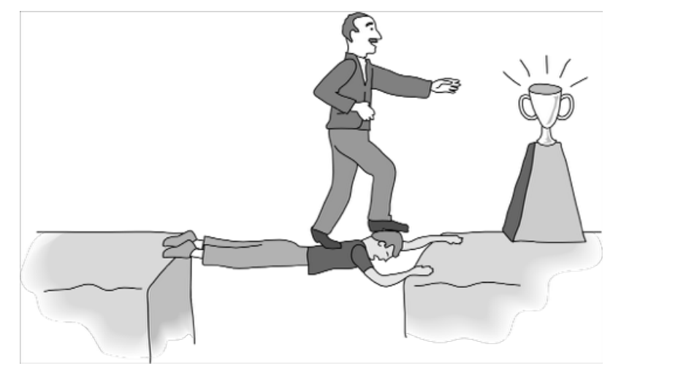
Kant: Wrong to Use Another Person Solely as a Means to an End

Slide 10
Scenario
Carla is a single mother who is working hard to complete her college education while taking care of her daughter. Carla has a full-time job and is taking two evening courses per semester. If she can pass both courses this semester, she will graduate. She knows her child will benefit if she can spend more time at home. One of her required classes is modern European history. In addition to the midterm and final examinations, the professor assigns four lengthy reports, which is far more than the usual amount of work required for a single class. Students must submit all four reports in order to pass the class. Carla earns an A on each of her first three reports. At the end of the term, she is required to put in a lot of overtime where she works. She simply does not have time to research and write the final report. Carla uses the Web to identify a company that sells term papers. She purchases a report from the company and submits it as her own work.
Was Carla’s action morally justifiable?

Slide 11
Plagiarism Scenario
Carla
– Single mother
– Works full time
– Takes two evening courses/semester
History class
– Requires more work than normal
– Carla earning an “A” on all work so far
– Carla doesn’t have time to write final report
Carla purchases report; submits it as her own work

Slide 12
Kantian Evaluation (1st Formulation
Carla wants credit for plagiarized report
Rule: “You may claim credit for work performed by someone else”
If rule universalized, reports would no longer be credible indicator’s of student’s knowledge, and professors would not give credit for reports
Proposal moral rule is self-defeating
It is wrong for Carla to turn in a purchased report

Slide 13
Kantian Evaluation (2nd Formulation)
Carla submitted another person’s work as her own
She attempted to deceive professor
She treated professor as a means to an end – End: passing the course – Means: manipulate professor
What Carla did was wrong

Slide 14
Case for Kantianism
Aligns with common moral concern: “What if everyone acted that way?”
Produces universal moral guidelines
Treats all persons as moral equals

Slide 15
Perfect and Imperfect Duties
Perfect duty: duty obliged to fulfill without exception
– Example: Telling the truth
Imperfect duty: duty obliged to fulfill in
general but not in every instance
– Example: Helping others

Slide 16
Case Against Kantianism
Sometimes no rule adequately characterizes an action
Sometimes there is no way to resolve a conflict between rules
– In a conflict between a perfect duty and an imperfect duty, perfect duty prevails
– In a conflict between two perfect duties, no solution
Kantianism allows no exceptions to perfect duties
Despite weaknesses, a workable ethical theory

Slide 17
Virtue Ethics

Slide 18
Critique of Enlightenment Theories
Utilitarianism, social contract theory ignore important moral considerations
– moral education
– moral wisdom
– family and social relationships
– role of emotions
• Virtue ethics
– arete, virtue, excellence: reaching highest potential
– Aristotle’s Nicomachean Ethics (4th century BC)

Slide 19
Virtues and Vices
Two types of virtue
– intellectual virtues: virtues associated with reasoning and truth
– moral virtues: virtues of character (e.g., honesty)
Moral virtues
– developed by habitually performing right action
– deep-seated character traits
– disposition to act in a certain way and feel in a certain way

Slide 20
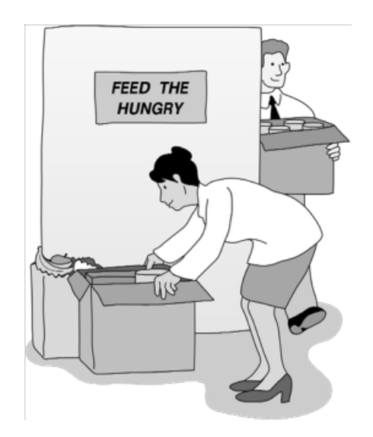
Aristotle: Happiness derives from living a life of virtue.

Slide 21
Summary of Virtue Ethics
A right action is an action that a virtuous person, acting in character, would do in the same circumstances.
A virtuous person is a person who possesses and lives out the virtues.
The virtues are those character traits human beings needs in order to flourish and be truly happy.

Slide 22
Vices
Vices are opposite of virtues
Vice: a character trait that prevents a human being from flourishing or being truly happy
Often, a virtue situated between two vices
– Courage between cowardliness and rashness
– Generosity between stinginess and prodigality

Slide 23
Case for Virtue Ethics
It often makes more sense to focus on virtues than obligations, rights, or consequences
Personal relationships can be morally relevant to decision making
Our moral decision-making skills develop over time
With this theory there are no irresolvable moral dilemmas
Emotions play an important role in living a moral life

Slide 24
Case Against Virtue Ethics
Reasonable people may disagree on character traits needed for human flourishing
Cannot use virtue ethics to guide government policy
Virtue ethics undermines attempts to hold people responsible for their bad actions
Despite weaknesses, virtue ethics a workable theory

Slide 25
Comparing Workable Ethical Theories

Slide 26
Objectivism vs. Relativism
Objectivism: Morality has an existence outside the human mind
Relativism: Morality is a human invention
Divine command theory, ethical egoism, utilitarianism, social contract theory, and virtue ethics examples of objectivism

Slide 27
Workable Ethical Theories
• We seek theories with these characteristics:
– Based on the ethical point of view
– Objective moral principles developed using logical reasoning based on facts and commonly held values
Workable ethical theories
– Kantianism
– Act and rule utilitarianism
– Social contract theory
– Virtue ethics

Slide 28
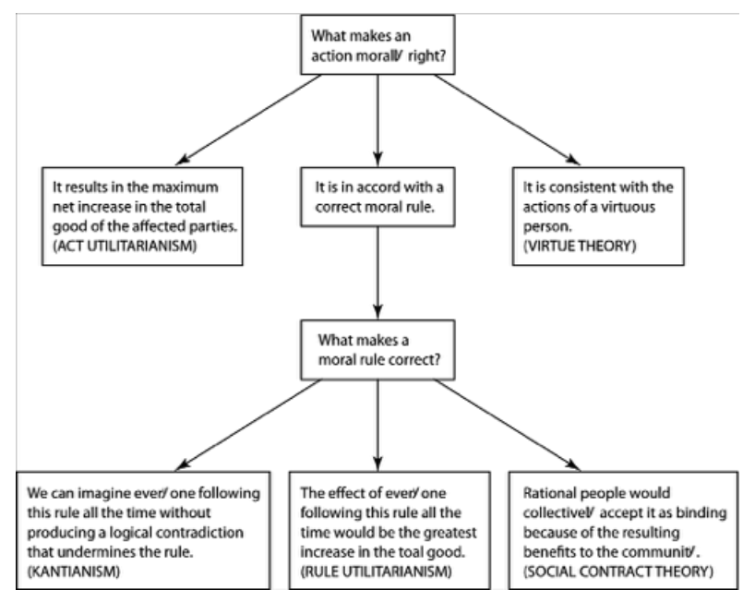
Comparing Workable Ethical Theories

Slide 29
Morality of Breaking the Law

Slide 30
Social Contract Theory Perspective
Everyone in society bears certain burdens in order to receive certain benefits
Legal system supposed to guarantee people’s rights are protected
Everything else being equal, we should be law-abiding
Should only break law if compelled to follow a higher-order moral obligation

Slide 31
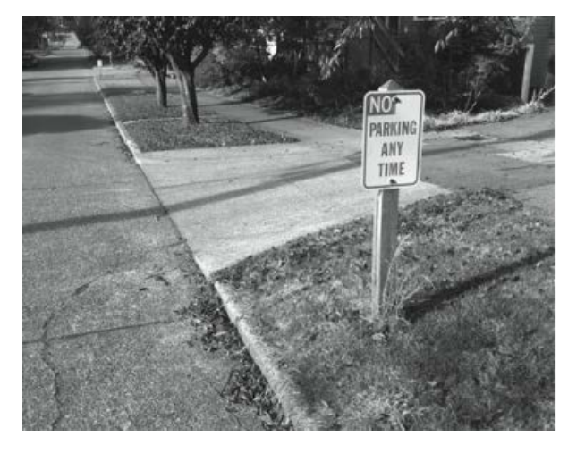
Social Contract: A Prima Facie Obligation to Obey the Law

Slide 32
Kantian Perspective
Everyone wants to be treated justly
Imagine rule: “I may break a law I believe to be unjust”
If everyone acted according to this rule, then laws would be subverted
Contradiction: Cannot both wish to be treated justly and allow laws to be subverted

Slide 33
Rule Utilitarian Perspective
What would be consequences of people ignoring laws they felt to be unjust?
Beneficial consequence: Happiness of people who are doing what they please
Harmful consequences: Harm to people directly affected by lawless actions, general loss of respect for laws, increased burden on criminal justice system
Harms greater than benefits

Slide 34
Act Utilitarian Perspective
Possible to conceive of situations where benefits of breaking law exceed harms
Suppose give penniless, bedridden friend copy of CD
Friend benefits by $15 (value of CD)
I benefit by $10 (satisfaction of helping friend)
Harms of $0 (no lost sale, no police involvement)
With $25 of benefit and $0 of harm, action is determined to be good

Slide 35
END OF LECTURE

